Slide 1
Clinical Imaging Informatics IAP 2017 Lab 3
Jayashree Kalpathy-Cramer (kalpathy@nmr.mgh.harvard.edu )
Henning Mueller (henning.mueller@hevs.ch)
Andrew Beers (ABEERS@mgh.harvard.edu)
Ken Chang (kenchang@mit.edu )
Artem Mamonov (AMAMONOV@mgh.harvard.edu )

Slide 2
Machine Learning for Healthcare (6.S897, HST.S53)
Instructor: David Sontag
Teaching assistant: Maggie Makar
Graduate Level; Units 2-0-4 (counts as an AAGS subject) Wednesdays 2:30-4pm, E25-119
URL (with syllabus): http://people.csail.mit.edu/dsontag/courses/mlhc17/
Course description:
Explores machine learning methods for clinical and healthcare applications. Covers concepts of algorithmic fairness, interpretability, and causality. Discusses application of time-series analysis, graphical models, deep learning and transfer learning methods to solving problems in healthcare. Considers how newly emerging machine learning techniques will shape healthcare policy and personalized medicine.

Slide 3
Labs (https://github.com/QTIM-Lab/IAP_ImgInf2017 )
Radiomics
Feature extraction (python https://github.com/QTIM-Lab/qtim_tools/blob/master/documentation/iPython_Tutorials/Feature_Extraction_Tutorial.ipynb
Classification (machine learning)
Deep learning with DIGITS
Flower classification

Slide 4
Introduction to NVIDIA Deep Learning GPU Training System (DIGITS)

Slide 5
Resources
Based on tutorial
https://www.learnopencv.com/deep-learning-example-using-nvidia-digits-3-on-ec2/
Data from
http://www.robots.ox.ac.uk/~vgg/data/flowers/17/
NVIDIA DIGITS
https://github.com/NVIDIA/DIGITS

Slide 6
What is DIGITS?
An interactive user interface that simplifies the task of data management, deep learning, and performance visualization
No programming required!

Slide 7
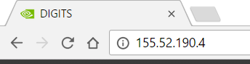
Getting Started
Open a browser and type in IP address 155.52.190.4

Slide 8
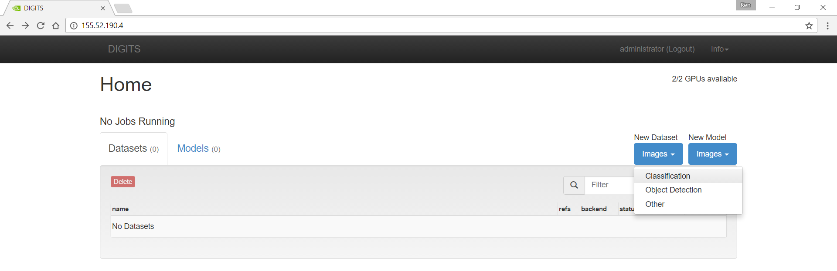
New Dataset > Images > Classification

Slide 9
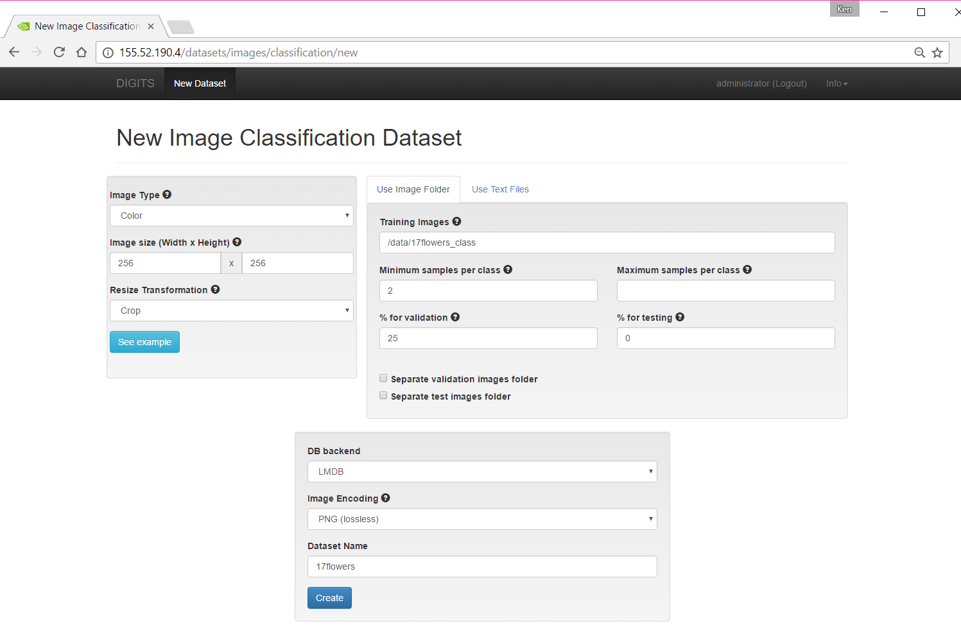

Slide 10
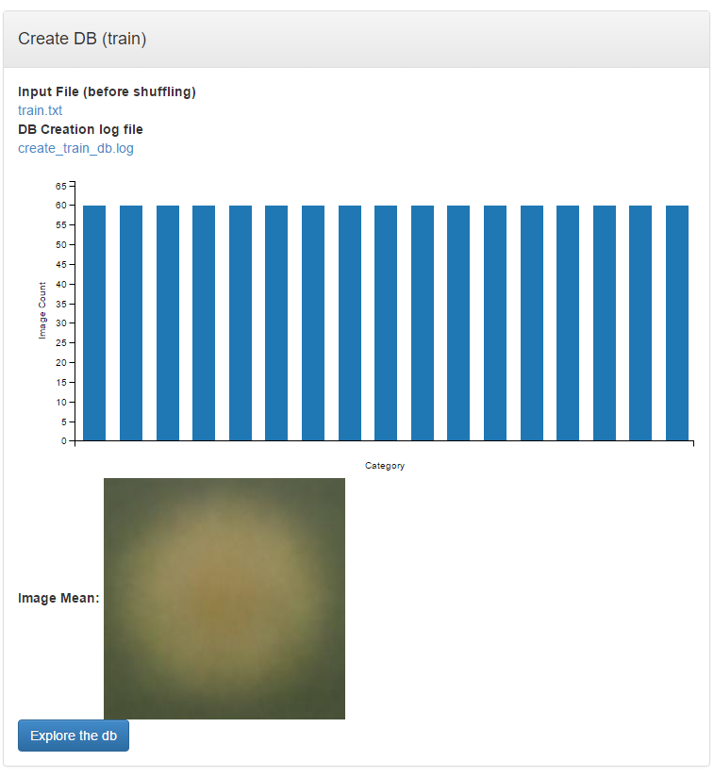
Let’s take a look at the dataset …

Slide 11
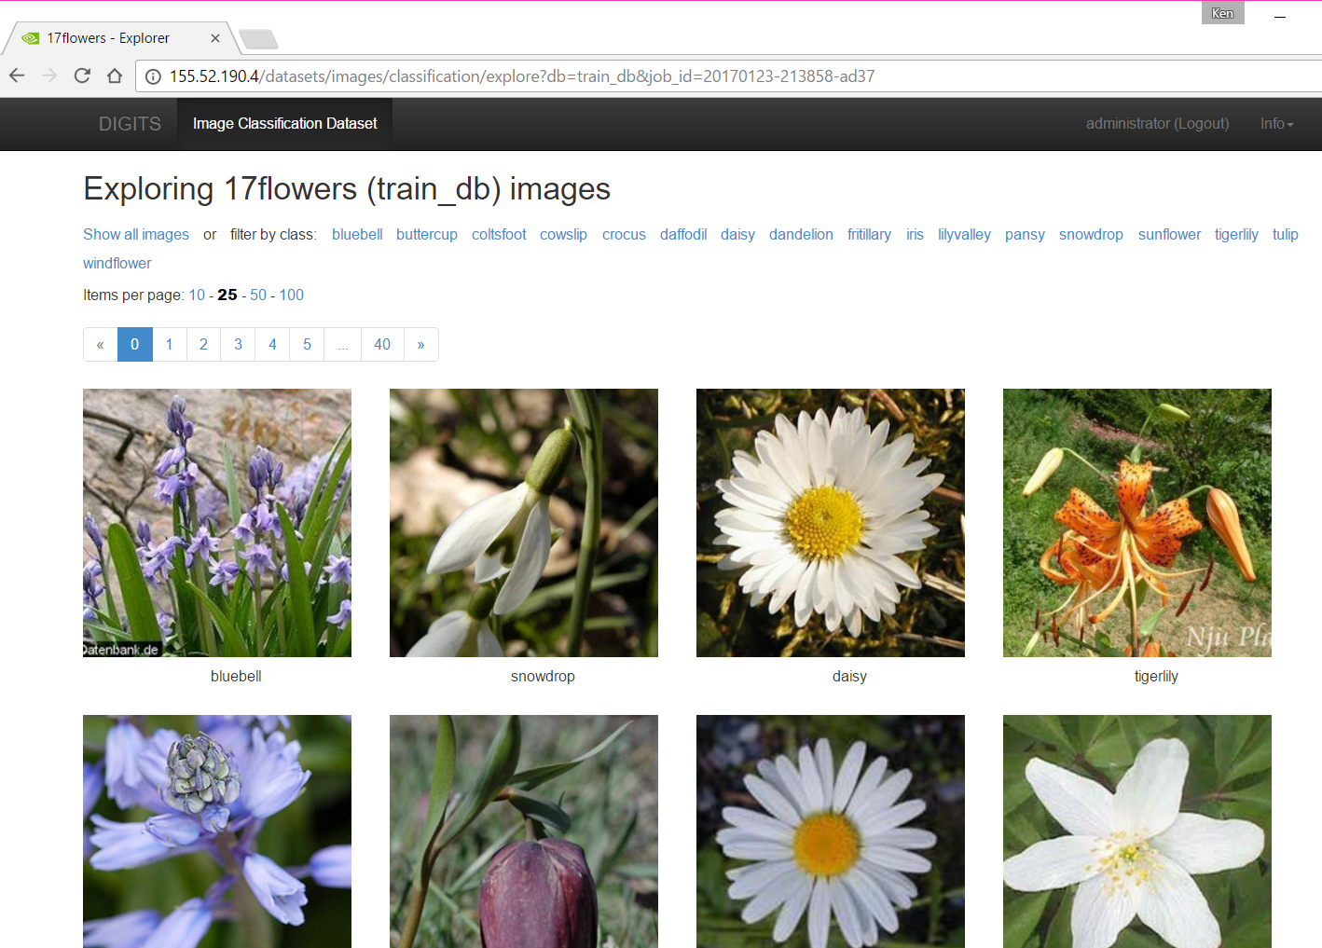
Click through the 17 categories of flowers!

Slide 12
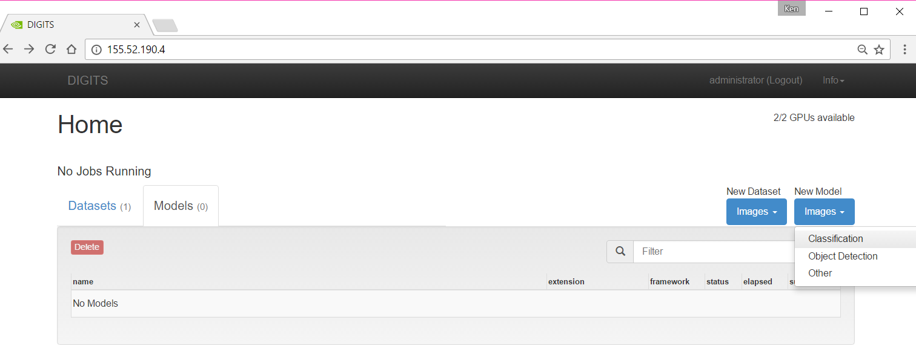
Let’s make our deep learning model
Click “DIGITS” in the top left corner to return to the home page

Slide 13
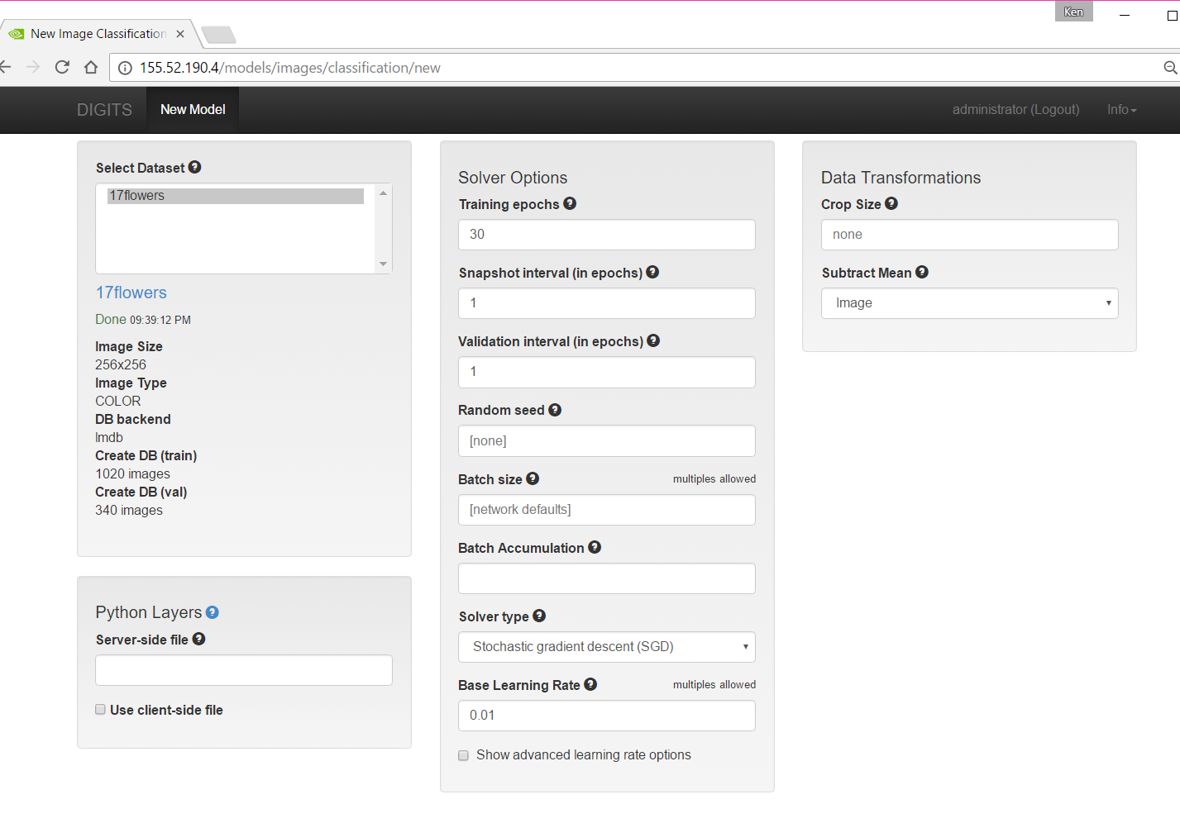

Slide 14
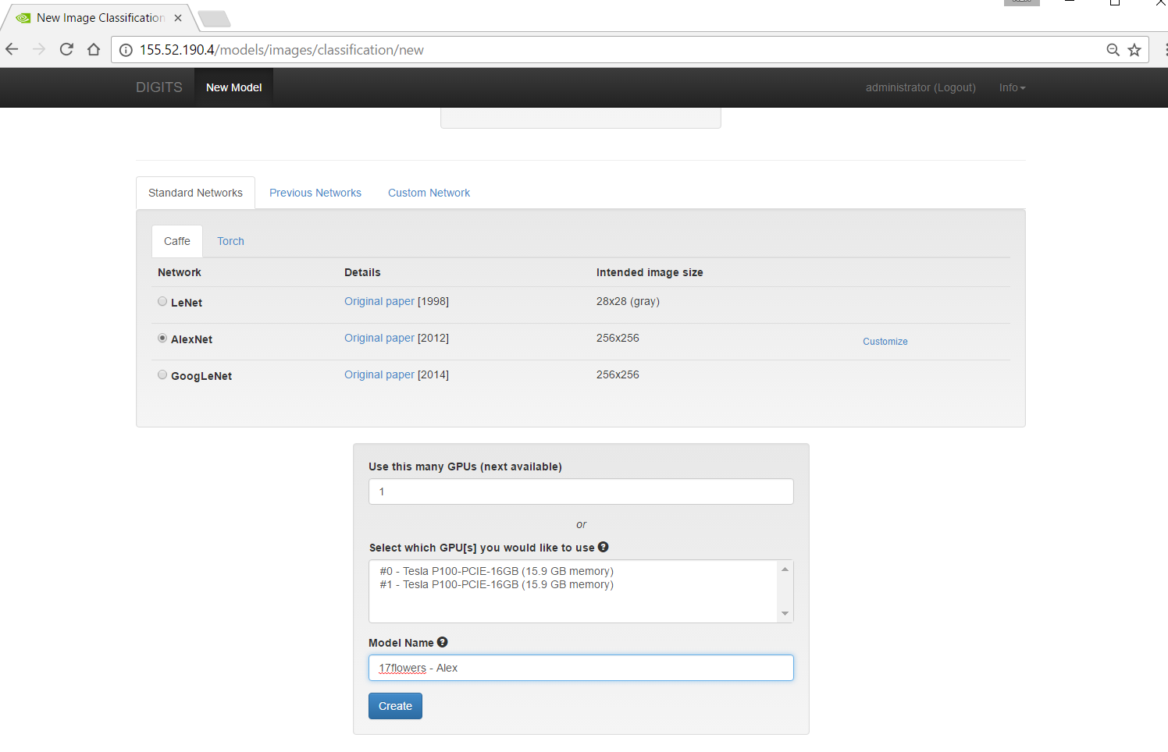

Slide 15
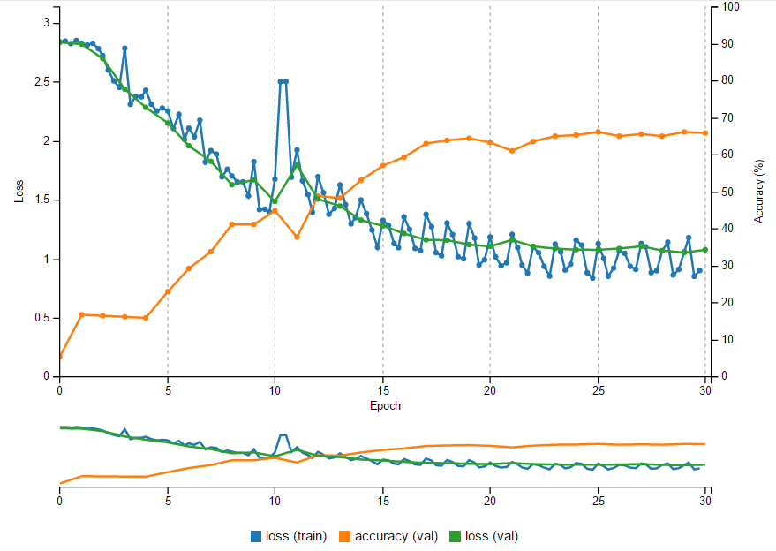
After a few minutes …
Validation Accuracy ~66% using default settings

Slide 16
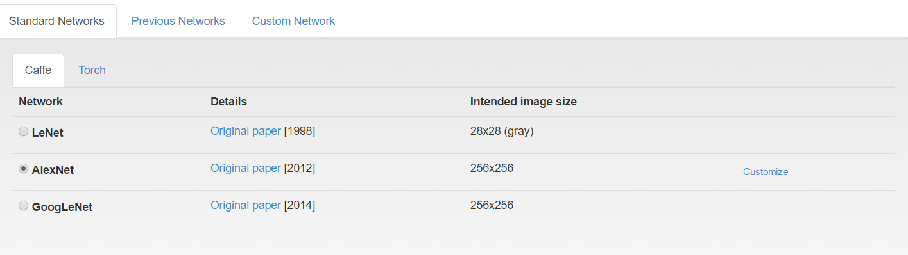
Can we do better?
Let’s try using pre-trained weights from the original AlexNet paper

Slide 17
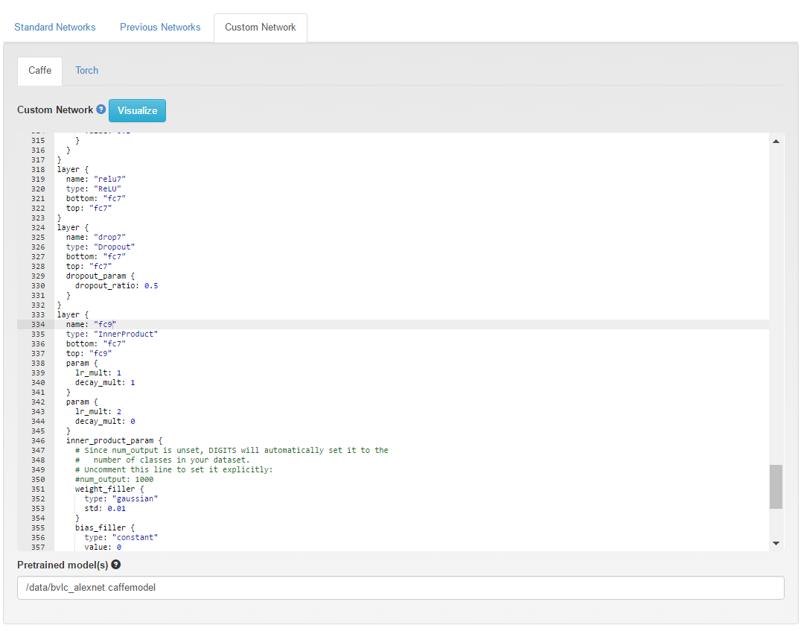
Make some small changes…
Replace all instances of “fc8” with “fc9”

Slide 18
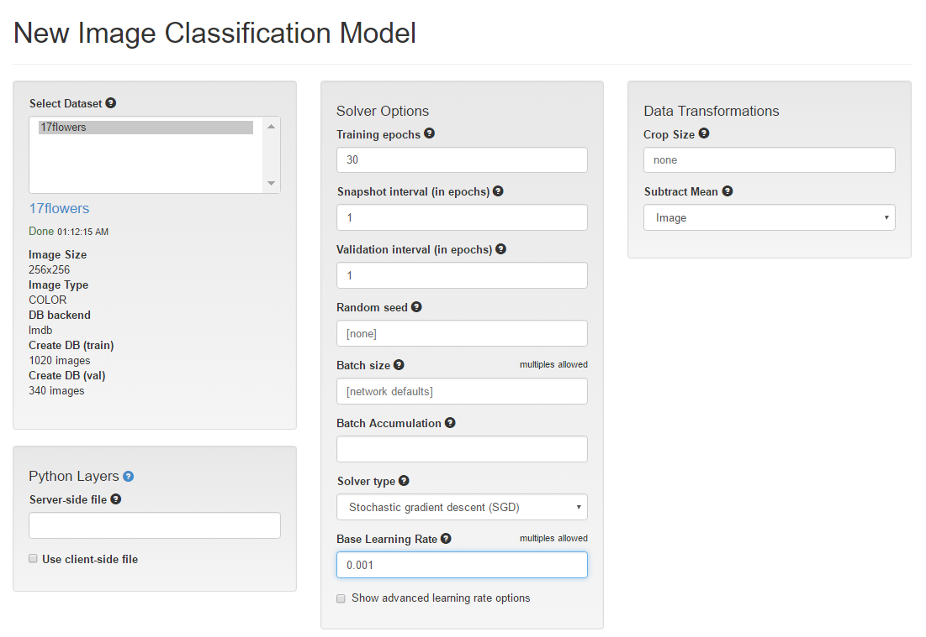
Reduce the learning rate

Slide 19
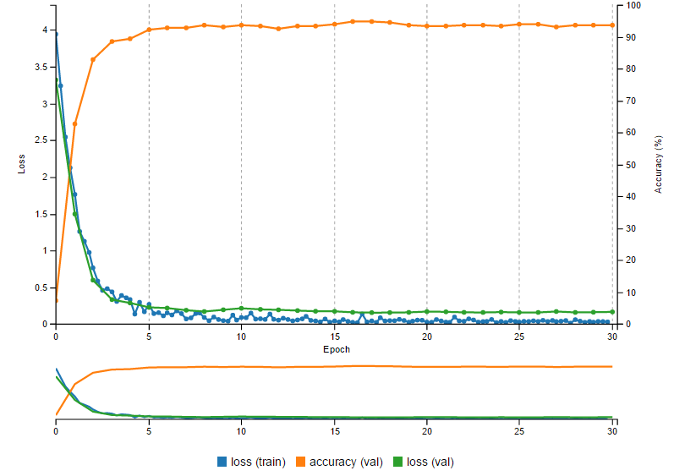
94% Validation Accuracy!

Slide 20
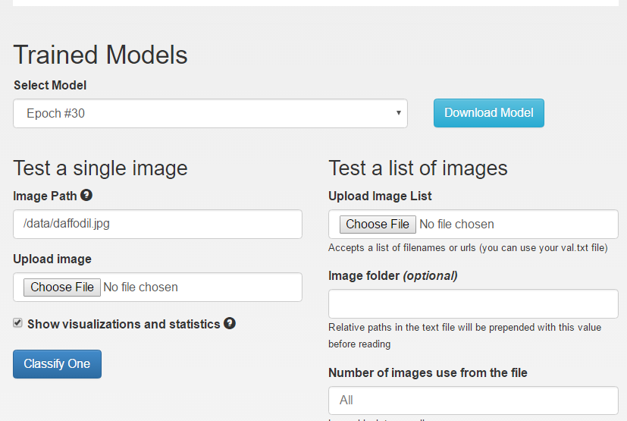
Let’s see if the classifier works on a new image …

Slide 21
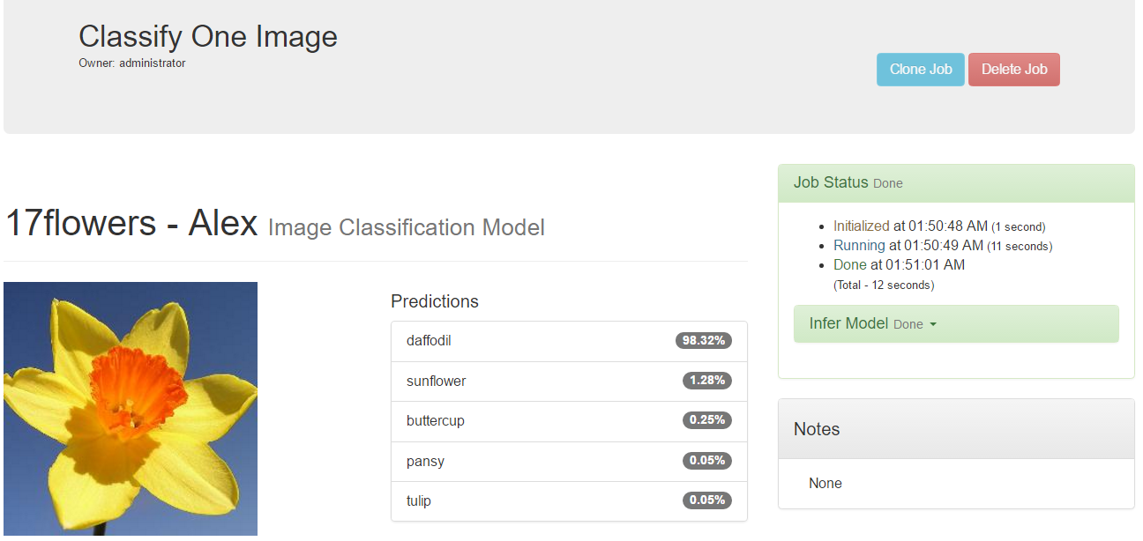
Success!

Slide 22
Challenges
For class use:
http://mgh-ccds.cloudapp.net/
If interested in taking further, please contact us and participate in
http://www.imageclef.org/2017/tuberculosis
https://www.kaggle.com/c/data-science-bowl-2017 ($1 million!!!)

